Slide 1
SBS Audio
Media Kit
2026

Slide 2
Contents
01
02
03
04
05
06
Cultural Makeup of Australia
Australia's Top Languages Are Evolving
Top Growing Languages
The SBS Audio Ecosystem
SBS Audio Delivers a Premium Environment
Radio

Slide 3

Cultural Makeup of Australia
Our country is becoming even more diverse and our attitudes towards diversity are increasingly positive.
The 2021 census told us that of 22 million Australians…
In Pew’s 2022 research on global attitudes, Australia tops a list of 15 major countries with 85% believing having a society made up of people from different ethnic, religious and/or social backgrounds, makes it a better place to live.
There’s also been significant growth in the number of Australians saying that this openness to people from diverse backgrounds is essential to who we are as a nation. An increase of 15% in three years.
Over 5.6 million
speak a language other
than English at home
850,000
Australians speak little
to no English
Over a quarter
of us were born overseas – with over half either being born overseas or with a parent who was.
3.2%
identify as Aboriginal or Torres Strait Islander – a 25% increase
on the previous census five years earlier. A sign – we hope of increased pride and confidence among First Nations Australians.
4.4 million
Australians have a disability
Source: ABS 2021 Census

Slide 4





Cultural Makeup of Australia
SBS Radio began more than 45 years ago, and has evolved to become an innovative, multi-platform media network. In 2023, we rebranded to SBS Audio.
SBS Audio is the world’s most linguistically diverse broadcaster and can connect your business with our valuable listeners through 60+ different language radio programmes, live streams and podcasts, accessible across multiple platforms:
ANALOG AM/FM
AND DAB
AUDIO APP
AND WEBSITE
DIGITAL
TELEVISION

Slide 5
Australia's Top Languages Are Evolving
Australia’s Top 10 Largest Language Groups
LANGUAGE | POPULATION | CHANGE FROM 2016 | (%)
1. Mandarin | 685,274 | +88,561 | +14.8%
2. Arabic | 367,159 | +45,436 | +14.1%
3. Vietnamese | 320,758 | +43,353 | +15.6%
4. Cantonese | 295,281 | +14,334 | +5.1%
5. Punjabi | 239,033 | +106,543 | +80.4%
6. Greek | 229,643 | -7,943 | -3.3%
7. Italian | 228,042 | -43,556 | -16%
8. Hindi | 197,132 | +37,479 | +23.5%
9. Spanish | 171,370 | +30,552 | +21.7%
10. Nepali | 133,068 | +62,004 | +114.6%
More than 5.6 million Australians speak a language other than English at home and these communities have changed since the 2016 census.
Source: ABS Census 2016 & 2021 Census of Population and Housing; Database: LANP (Language Other Than English Spoken at Home)

Slide 6
Top Growing Languages
LANGUAGE | CHANGE FROM 2016 | (%)
1. Punjabi | +110,000 | 80.40%
2. Mandarin | +90,000 | 14.80%
3. Nepali | +80,000 | 114.60%
4. Arabic | +47,000 | 14.10%
5. Vietnamese | +43,000 | 15.60%
6. Spanish | +40,000 | 21.70%
7. Hindi | +30,000 | 23.50%
8. Tamil | +20,000 | 30.40%
9. Filipino | +20,000 | 27.60%
10. Urdu | +10,000 | 61.40%
Source: www.sbs.com.au/news/creative/census-explorer data from the 2021, 2016 and 2011 ABS Census. Database-Language used at home (LANP) Census of Population and Housing: Census dictionary. Reference period 2021

Slide 7






The SBS Audio Ecosystem
The SBS Audio offering is diverse and distinctive – with a mix of traditional radio, digital live streams, catch up, podcasts, and dedicated music and news channels, there is something for everyone.
Click here to watch
SBS Audio Master Reel
Traditional Radio
/Live Streams
Broadcasting in over 60 different languages each hour brings news and entertainment to Multicultural Australia.
The
Music Channels
Ecosystem
In English and in languages other than English that cover topics such as entertainment, food, news, health, family, parenting and much more.
Podcasts

Slide 8



SBS Audio Delivers a Premium Environment
SBS Audio delivers a premium environment for our advertising partners and is grounded
in four key pillars:
01. Trust
02. Low Clutter
03. Unique Content
04. Diverse Audiences
SBS is the number 1 trusted media brand amongst people who speak a language other than English.
With only 5 minutes of
ads per hour, a low-clutter environment maximises
cut-through and helps advertisers achieve higher recall for their brands.
Premium in nature and delivered with purpose to reflect Australia’s diverse cultural make up. It is tailored by specific migration patterns and up-to-date census data.
Providing access to a unique, highly engaged and valuable audience who are difficult for brands to reach.

Slide 9



SBS RADIO
Starting in 1975 to promote Australia's new healthcare system Medicare, SBS Radio is the world’s most linguistically diverse broadcaster, a bridge linking to the 21% of Australians who speak another language than English.
SBS Radio 1, 2, 3 programs broadcast the latest Australian news and information and international current affairs in over 60 languages. Our content is tailored based on specific migration patterns, settlement information, and robust talkback where audiences partake in discussion with the broadcasters.
With each hour being dedicated to a different language community, our content is truly appointment to listen. Our clients can target specific in-language programs nationally or by state.
SBS Radio also houses NITV Radio, which has a unique national focus on news, events and issues that affect Aboriginal and Torres Strait Islander communities. NITV Radio is a channel made by, for and about, Aboriginal and Torres Strait Islander communities, where interviews, features, and community stories
are available.
Click here to watch
SBS Audio Reel – Audience

Slide 10



Music Channels
Bringing audiences music from around the world with our
three dedicated music channels, PopAsia, PopDesi and SBSChill.
SBS PopAsia is Australia’s leading Asian pop music and pop culture network. PopAsia connects with young Asian
music fans across the country through
its amalgamation of K-Pop, J-Pop and
C-Pop from across Asia.
SBS South Asian is a digital music radio station to cater to Australia’s growing South Asian youth market. SBS South Asian plays the hottest Bollywood hits & Bhangra tracks.
SBS Chill is your ultimate relaxation station. It comprises a range of genres and sounds, including downtempo, electronic, ambient and lo-fi tunes from around the world, as well as the Chillest 100 – the coolest countdown of music for the year.
BROADCASTING NATIONALLY ON DIGITAL RADIO, MOBILE AND ONLINE 24/7

Slide 11
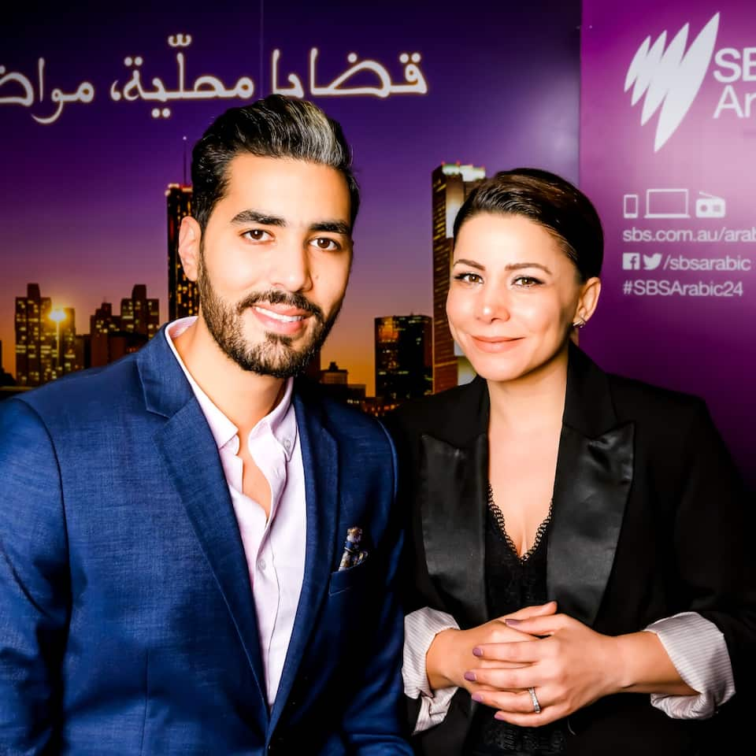
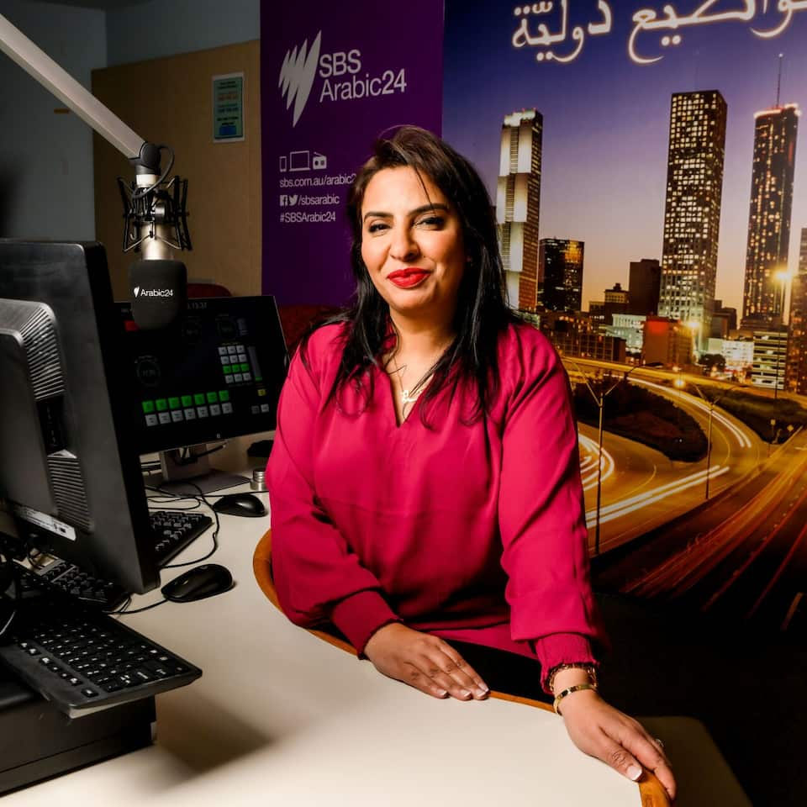
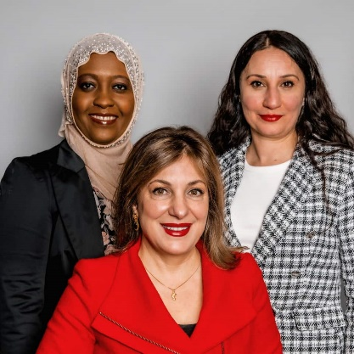
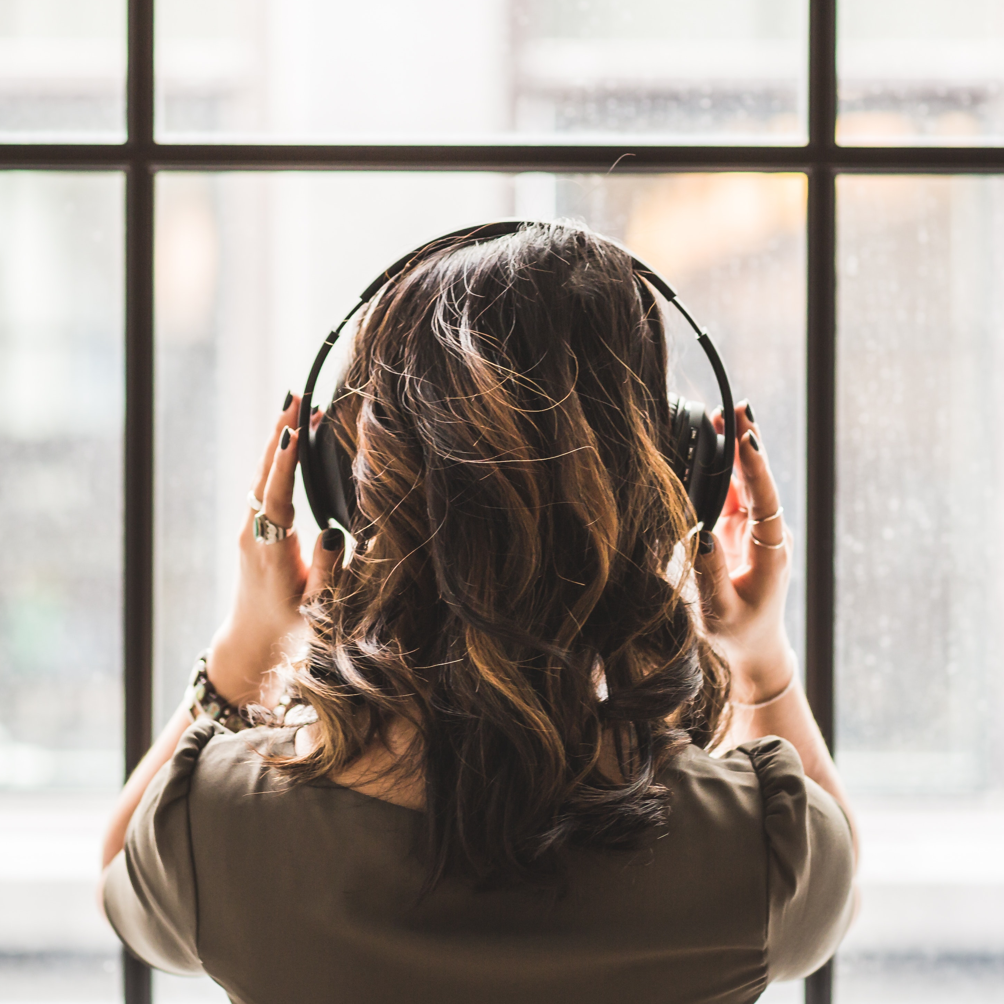
Arabic 24
SBS Arabic24 is a 24/7 in-language radio service and online hub that broadcasts the latest news, entertainment and lifestyle content to Australia’s vibrant Arabic speaking community. It aims to ensure they have access to trustworthy, informative and unbiased news and information around the clock, and on their platform of choice.
Some of the great content includes:
Good Morning Australia
Bayt Al Mazzika Live
Australia Alyaom
Pop Arabi – the best of Arabic music

Slide 12
Digital Audio
2022 saw the launch of the next phase in SBS’ commercial broadcast offering, digital audio. This momentous development extends on our more than 45 years of radio broadcasting and 15 years and counting of podcast creation. It also piggybacks off the army of an estimated 16 million strong Aussies who are listening to digital audio each week (Edison Infinite Dial 2023).
By including SBS Audio as part of your next media campaign, you’ll reach diverse Australian listeners you won’t find elsewhere. Inventory can be bought both programmatically and direct, by impressions, and with the added peace of mind of post campaign reporting. Our menu of content on offer has expanded, including our
60+ in language programs, three dedicated music stations, as well as a myriad of genres across our podcasts in multiple languages including English.
The success of releases such as On The Money with Ricardo Goncalves, Eyes On Gilead (companion to The Handmaid’s Tale) and The Ugly Ducklings of Italian Cuisine along with many others earnt SBS the ‘Best Publisher Award’ at the 2022 Australian Podcast Awards. Our content not only strikes a chord with domestic audiences but is in demand internationally. Our global success is also something clients looking for audiences beyond our borders can now capitalise on.
Click here to hear this article

Slide 13
South Asian languages
SBS AUDIO MEDIA KIT
HINDI
Daily 5-6pm
SBS Radio 2
Daily 5-6pm
SBS Pop Desi
PUNJABI
Weekdays 9-10pm
SBS Radio 2
Weekdays 4-5pm
SBS Pop Desi
TAMIL
Mon, Wed, Fri,
Sun 8-9pm
SBS Radio 2
Mon,Wed, Thur, Fri 12-1pm
SBS Pop Desi
SINHALA
Mon, Tues, Thur, Fri, 11-12pm
SBS Radio 2
Mon, Tues, Thur, Fri 11-12pm
SBS Pop Desi
MALAYALAM
Thurs 8-9pm
Sun 9-10pm
SBS Radio 2
Thur, Fri 1-2pm
SBS Pop Desi
BANGLA
Mon, Sat 6-7pm SBS Radio 2
Thur, Fri 1-2pm
SBS Pop Desi
GUJARATI
Wed, Fri 4-5pm
SBS Radio 2
Wed, Fri 2-3pm
SBS Pop Desi
NEPALI
Thurs, Sun 4-5pm SBS Radio 2
Tues, Thur 2-3pm
SBS Pop Desi
URDU
Wed, Sun 6-7pm SBS Radio 2
Wed, Fri 3-4pm
SBS Pop Desi
PASHTO
Tues, Sat 2-3pm
SBS Radio 2
TELUGU
(Added in LSR)
Digital
KAREN
Digital
HAKHA CHIN
Digital
TIBETAN
Digital
ROHINGYA
Digital
Asian languages
CANTONESE
Daily 9-11am
SBS Radio 1
MANDARIN
Daily 7-9am
SBS Radio 1
VIETNAMESE
Daily 7-9pm
SBS Radio 1
FILIPINO/TAGALOG
Daily 10–11am
SBS Radio 2
INDONESIAN
Mon, Wed, Fri,
Sun 3-4pm
SBS Radio 2
KOREAN
Daily 9-10pm
SBS Radio 1
Mon-Fri 4-5pm
SBS Radio 3
THAI
Mon, Thurs
10–11pm
SBS Radio 2
Mon, Thurs 2–3pm
SBS Radio 3
JAPANESE
Tues, Thurs, Sat 10-11pm
SBS Radio 1
Tues, Thur, Fri
1-2pm
SBS Radio 3
HMONG
Thurs 6-7pm
Sun 11am-12pm
SBS Radio 2
BURMESE
Tues, Sat 10-11pm
SBS Radio 2
Tues, Thur 12-1pm
SBS Radio 3
LAO
Mon 4-5pm
Sat 9-10pm
SBS Radio 2
MONGOLIAN
Tues 2–3pm
SBS Radio 3
Digital
MALAY
Digital

Slide 14
African Languages
SBS AUDIO MEDIA KIT
AMHARIC
Mon, Fri 10-11pm
SBS Radio 1
Mon, Wed 12-1pm
SBS Radio 3
DINKA
Wed, Sat 11-12pm SBS Radio 1
Wed, Fri 11-12pm
SBS Radio 3
TIGRINYA
Mon, Thur 6-7pm SBS Radio 1
Mon, Thur 11-12pm
SBS Radio 3
SOMALI
Wed, Fri 10-11pm
SBS Radio 2
Mon, Wed 1-2pm
SBS Radio 3
SWAHILI
Tues 6-7pm
Sun 10-11pm
SBS Radio 2
Tues 11-12pm
Fri 12-1pm
SBS Radio 3
OROMO
Digital
European languages
SPANISH
Daily 1-2pm
SBS Radio 2
CROATIAN
Mon, Tues, Thurs, Fri 11-12pm
SBS Radio 1
ARMENIAN
Tues, Sun 6-7pm
SBS Radio 1
BOSNIAN
Tues 2-3pm
Sun 3-4pm
SBS Radio 1
FRENCH
Tues, Thurs, Sat, Sun 1-2pm
SBS Radio 1
DUTCH
Wed, Sat 11-12pm
SBS Radio 2
GERMAN
Mon - Fri 7-8pm
SBS Radio 2
Mon - Fri 3-4pm
SBS Radio 3
GREEK
Daily 4-6pm
SBS Radio 1
ITALIAN
Daily 8-10am
SBS Radio 2
MACEDONIAN
Mon - Sat
12-1pm
SBS Radio 1
PORTUGUESE
Wed, Sun
12 -1pm
SBS Radio 2
MALTESE
Tues, Fri 12-1pm
SBS Radio 2
RUSSIAN
Mon, Thurs, Sat
12-1pm
SBS Radio 2
POLISH
Mon, Wed, Thurs Fri, Sun 2-3pm
SBS Radio 1
SERBIAN
Mon, Tues, Thurs, Sat
3-4pm
SBS Radio 1
UKRAINIAN
Fri 6-7pm
SBS Radio 2
TETUM-NATIVE
Digital

Slide 15

Middle Eastern Languages
SBS AUDIO MEDIA KIT
ARABIC
Daily 6-8am
SBS Radio 2
PERSIAN/FARSI
Tues, Sat 3-4pm
SBS Radio 2
HEBREW
Sun 11-1pm
SBS Radio 1
TURKISH
Mon, Wed, Thurs, Fri 2-3pm
SBS Radio 2
KURDISH
Thurs 3-4pm
Sun 2-3pm
SBS Radio 2
ASSYRIAN
Tues, Sat 8-9pm
SBS Radio 2
DARI INCLUDING HAZARAGI
Tues, Sat 4-5pm
SBS Radio 2
ARABIC 24
Digital
Pacific Island Languages
English Languages
SAMOAN
Wed, Sun 10-11pm SBS Radio 1
Wed, Fri 2-3pm SBS Radio 3
BISLAMA
Digital
NITV RADIO
Mon, Wed, Fri
1-2pm
Weds, Fri, Sat
6-7pm
SBS Radio 1

Slide 16
Buying options
There are a variety of advertisement options available to best suit your needs.
Commercial spot buy
Audience targeting
Client Integration
Events
Available in standard duration lengths
(15s, 30s, 45s, 60s), minimum 30s for
in-language ads.
The most ubiquitous duration for digital audio is max 30 sec. Durations beyond this can be accommodated on podcast pre rolls (max 45 sec) and midrolls (max 60 sec), and/or Dynamic Ad Insertion (DAI) on live streams (SBS1, SBS2, max 45 sec).
Advertisements can be supplied to us, or we can engage SBS Media’s specialist in-house production team and assist in writing, translating/ transcreation and recording the advertisement.
Fees apply.
SBS In Language website
For linear radio, we focus on reaching specific community groups by language. This can also be targeted nationally or by state.
Across digital audio, additional targeting and measurability is also available with more granular location data, audience, contextual and daypart targeting
Access a raft of additional opportunities through SBS Media’s CulturalConnect team who specialise in building brand partnerships.
Some solutions include:
Sponsorships
Audio advertorials
Competitions
SBS engages with its loyal culturally and linguistically diverse audience on ground by attending events and festivals each year.
Corporate client event sponsorship information is available on request.
Key events on our calendar include Lunar New Year, Diwali, Harvest Moon Festival, Ramadan and EID.

Slide 17




SBS Language and Cultural Tools
SBS In-language production
SBS has been the trusted leader in multilingual services since 1975. With our unique multicultural expertise, we offer a highly professional and comprehensive media production facility.
We create advertising materials for all platforms and communication channels and manage our clients’ projects to the highest professional standard from beginning to end.
Our unique offering includes:
Translations and transcreations
Typesetting
Voice overs & Re-narration
Video Production
Subtitling
Cross Cultural Consultancy
SBS In Language holds a QMS certification (ISO 9001) and offers NAATI-accredited translations.
Census Explorer
Based on the 2021 Census results, the Census Explorer provides a snapshot of country.
Cultural Atlas
The Cultural Atlas is an educational resource providing comprehensive information on the cultural background of Australia’s migrant populations.
CulturalConnect
SBS CulturalConnect provides services in strategy, research and insights, integrated brand solutions, creative and in-language production, inclusion training and consultancy.
Heat Maps
Tailored heat maps identifying LOTE communities across Australia.

Slide 18
Audio Advertising Specifications
Material Deadlines & Considerations
Audio Advertising
Standard & Third Party Material
Length (seconds)​ | 15, 30 (live streams only), 15, 30, 45 (podcast pre and post-roll only)​, 60 (podcast mid-roll only)
Audio levels​ | -16 to –20LKFS with a -2dB True Peak (TP)​
Max file size​ | 10mb​
Format​ | WAV only​
3rd party accepted tags | Google (Double-click) *Other 3rd party tags - subject to testing
Other restrictions​ | Non-clickable, No multiple VAST wrappers​, no MOAT or IAS capabilities
5 Business days prior to start of a campaign
SBS adheres to within 10% reporting discrepancy as industry standard.
SBS reserves the right to remove any advertising that does not comply with our specifications, contravenes any of these guidelines or adversely affects the rendering of our site, other ad placements or user experience.
Please provide all ad creative to your SBS Sales Rep.
Please speak to your sales rep about which environments allow English advertisements or require in-language advertisements
3rd party tags must be VAST 2.0 compliant
Commercial durations need to be within 1% either side of booked airtime ​
​Our contract with advertisers (SBS Advertising Terms and Conditions) requires advertisers to warrant that their ads comply with relevant laws

